Slide 1
Bauman Moscow State Technical University
Department of Fundamental Sciences
Laboratory of solid-state lasers and nonlinear optics
Fields of research:
Diode pumping of pulsed solid-state lasers.
Multistage pulsed solid-state lasers.
Nonlinear optical frequency conversion.
Members:
Evgeny Sharandin (PhD)
Pavel Nikolaev (PhD)
Alexander Skrabatun (postgraduate)
Gevork Manucharyan (student)

Slide 2
Diode pumping of pulsed solid-state lasers
Mathematical modeling of the diode pumping process of pulsed solid-state lasers using self-developed software.
Mathematical modeling of thermal and hydrodynamic processes in laser heads.
Development and optimization of various diode-side-pumped schemes of pulsed solid-state lasers.
Fabrication and assembly of diode-side-pumped laser heads for pulsed solid-state lasers.

Slide 3
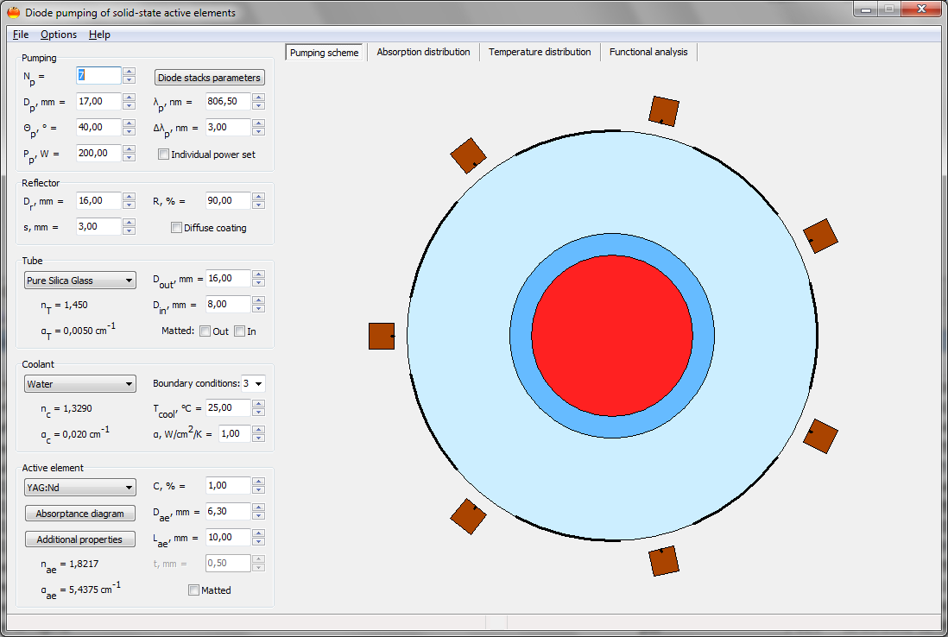
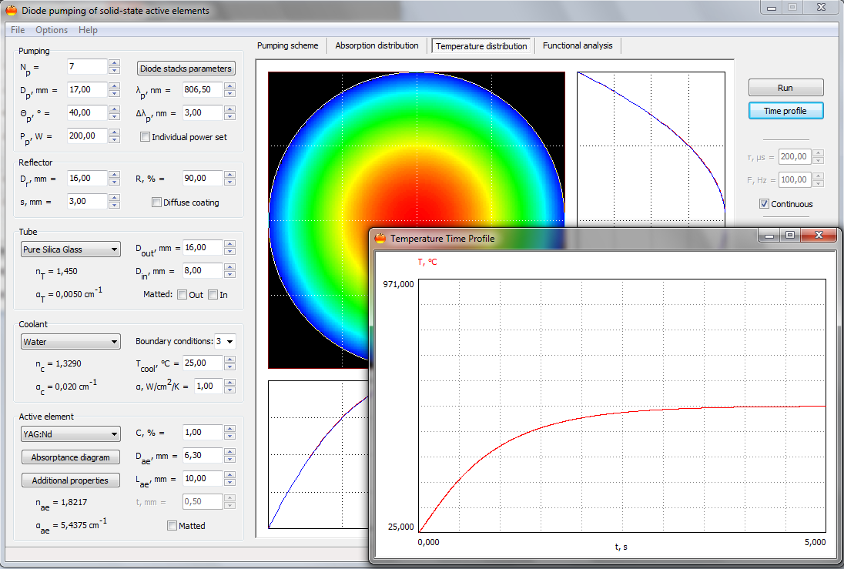
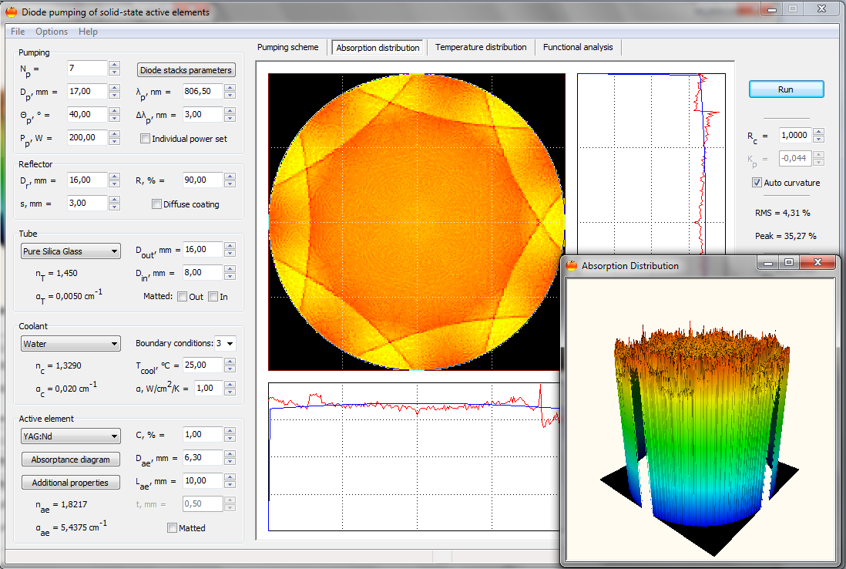
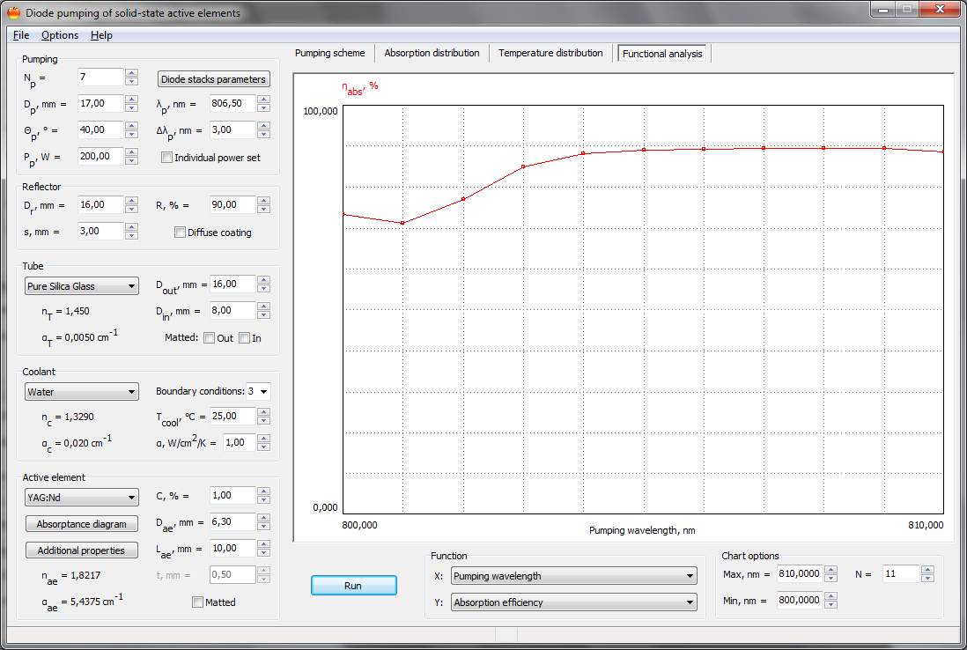
Mathematical modeling of the optical pumping process

Slide 4
Mathematical modeling of processes in laser heads
Mathematical modeling of hydrodynamic processes
Mathematical modeling of thermal processes

Slide 5
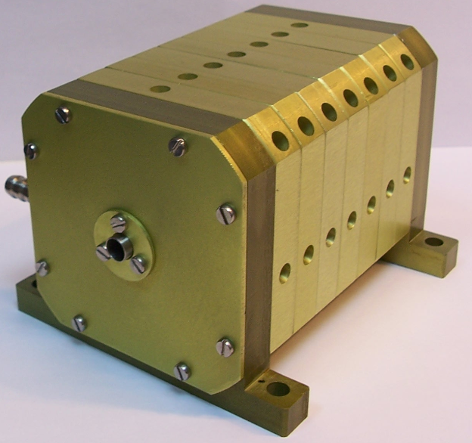
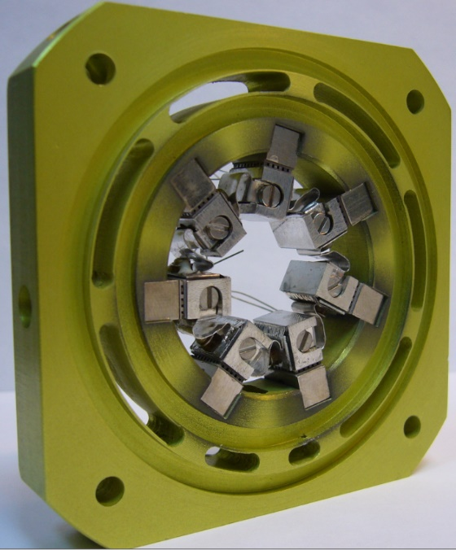
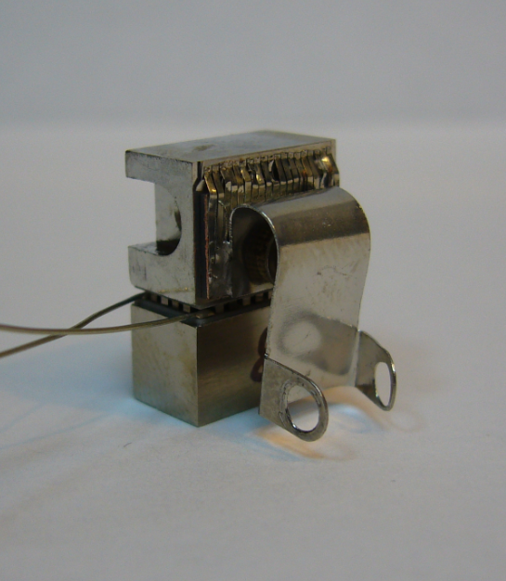
Diode-side-pumped laser heads with linear sources
Maximum peak power – 10 kW;
Maximum pulse width – 500 μs;
Maximum repetition rate – 50 Hz;
Maximum optical efficiency (free-run) – 40 %;
Maximum optical efficiency (QCW) – 20 %;
Maximum output energy (free-run) – 2 J;
Maximum output energy (QCW) – 1 J

Slide 6
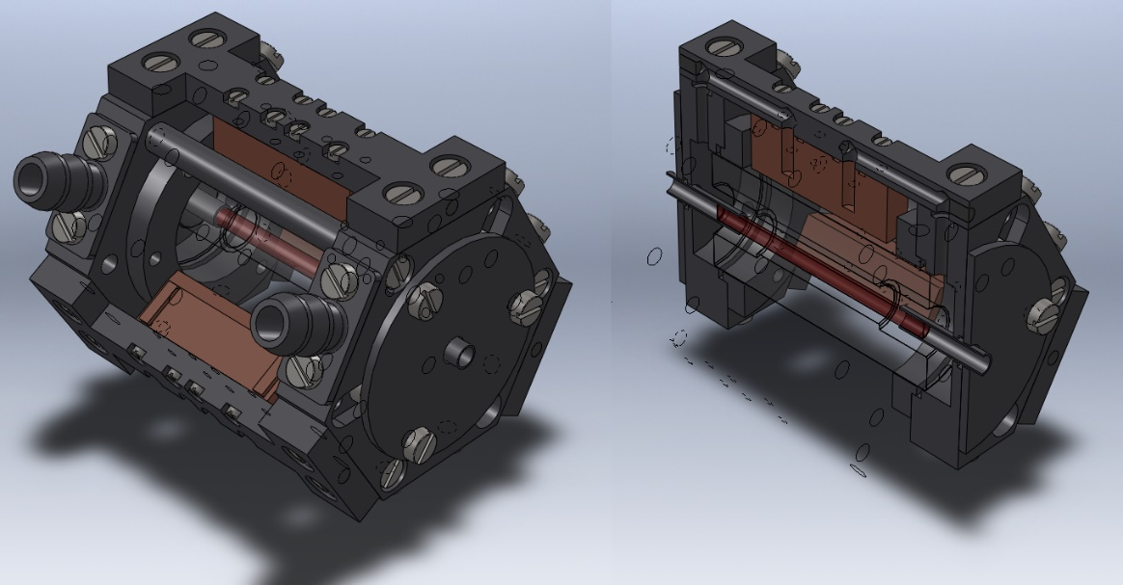
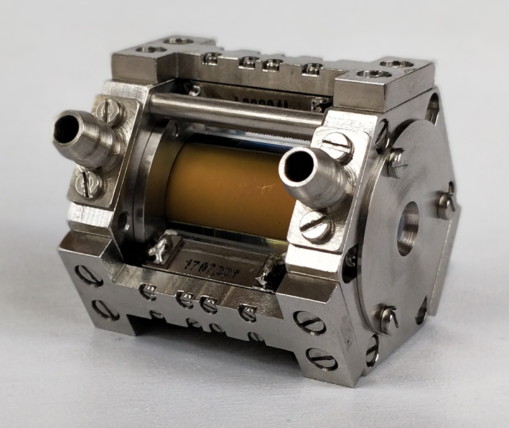
Diode-side-pumped laser heads with matrix sources
Maximum peak power – 20 kW;
Maximum pulse width – 500 μs;
Maximum repetition rate – 100 Hz;
Maximum optical efficiency (free-run) – 40 %;
Maximum optical efficiency (QCW) – 20 %;
Maximum output energy (free-run) – 4 J;
Maximum output energy (QCW) – 1 J

Slide 7
Multistage pulsed solid-state lasers
Mathematical modeling of the generation and amplification in Q-switched multistage solid-state lasers using self-developed software.
Mathematical modeling and experimental studies of the formation of energy, time, and polarization parameters of the laser radiation in multistage lasers in the presence of intercascade couplings.
Mathematical modeling and experimental studies of processes of formation of spatial characteristics of light beams in multistage lasers with inhomogeneous distribution of population inversion in active elements.
Fabrication and assembly of Q-switched multistage solid-state lasers.

Slide 8
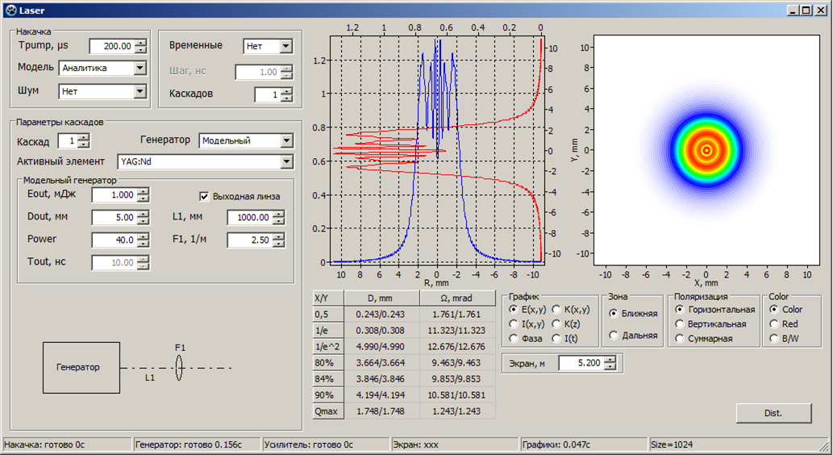
Mathematical modeling of generation and amplification in Q-switched multistage solid-state lasers

Slide 9
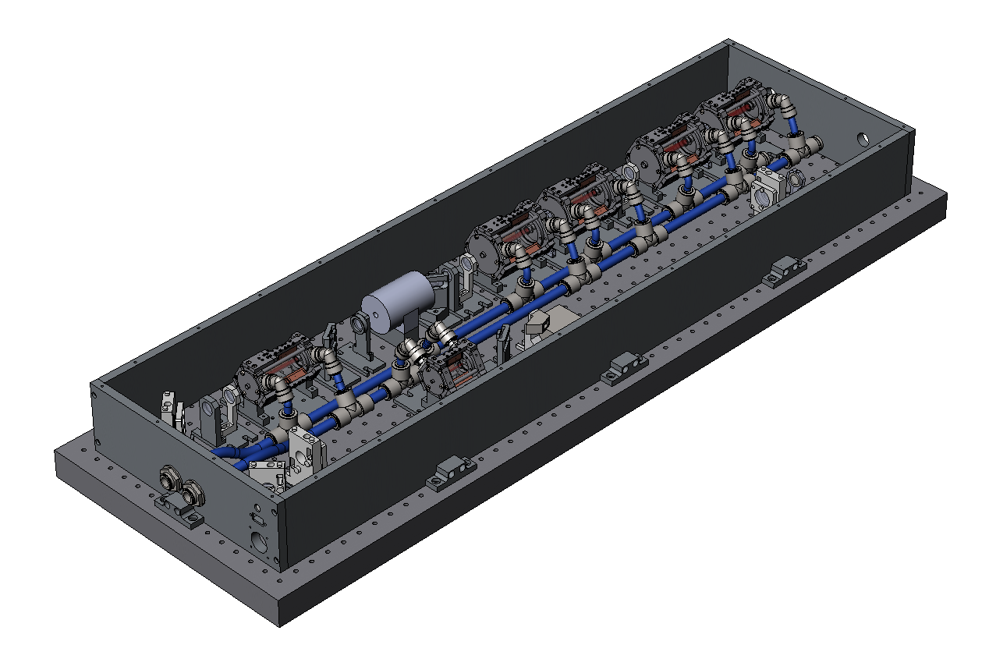
1 J Q-switched multistage solid-state lasers

Slide 10
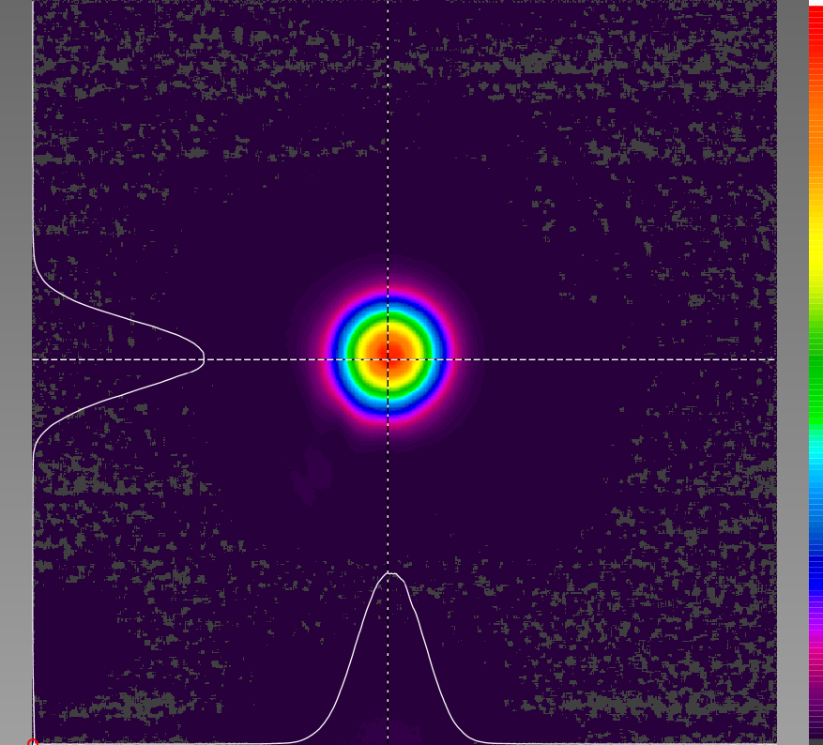
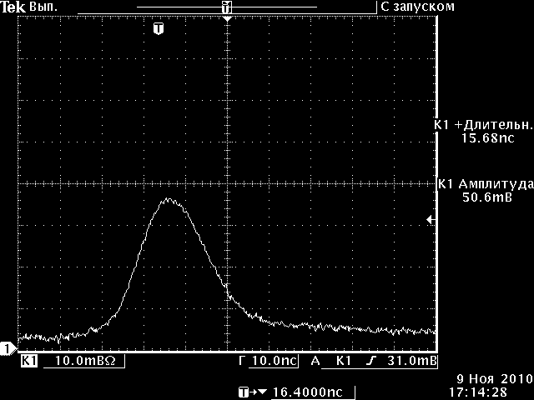
1 J Q-switched multistage solid-state lasers
Spatial distribution of the laser beam
Oscillogram of the laser pulse
Laser wavelength – 1064,2 μm;
Pulse width – 15 ns;
Maximum repetition rate – 100 Hz;
Maximum output energy – 1 J;
Maximum optical efficiency – 18 %;
Full divergence of laser beam – < 0,5 mrad

Slide 11
Nonlinear optical frequency conversion
Mathematical modeling of nonlinear optical frequency conversion processes of laser radiation using self-developed software.
Development and optimization of various nonlinear optical frequency conversion schemes for a wide range of applications.
Fabrication and assembly of thermostabilized nonlinear optical harmonic generators: from second to fifth for 1,0642 µm laser radiation.
Fabrication and assembly of tunable optical parametric oscillators in mid-infrared spectral range.

Slide 12
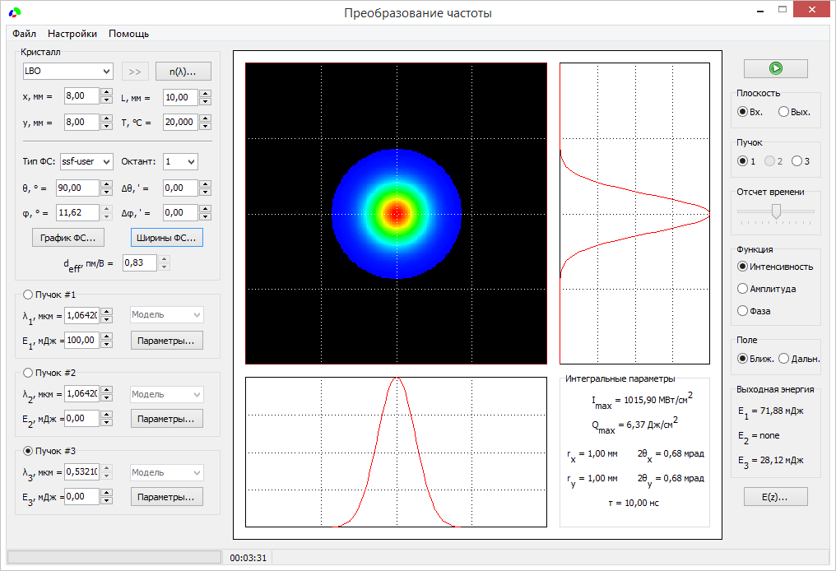
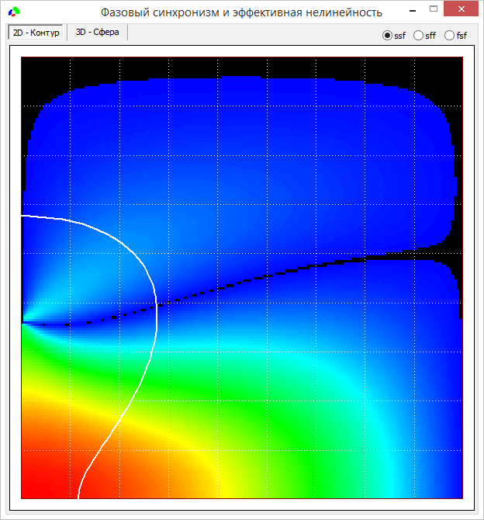
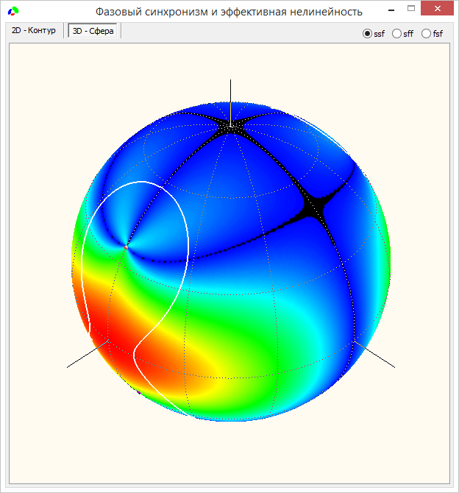
Mathematical modeling of nonlinear optical frequency conversion process

Slide 13
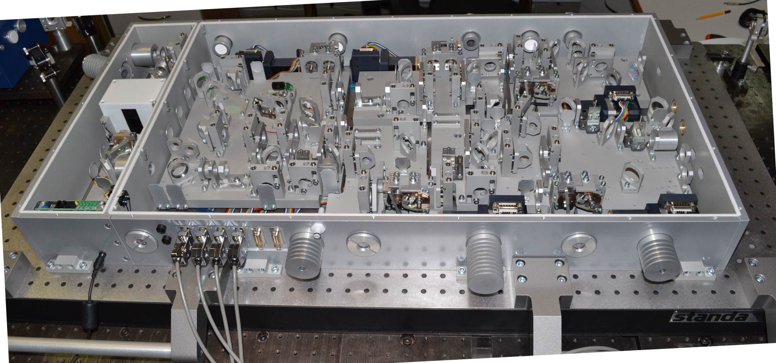
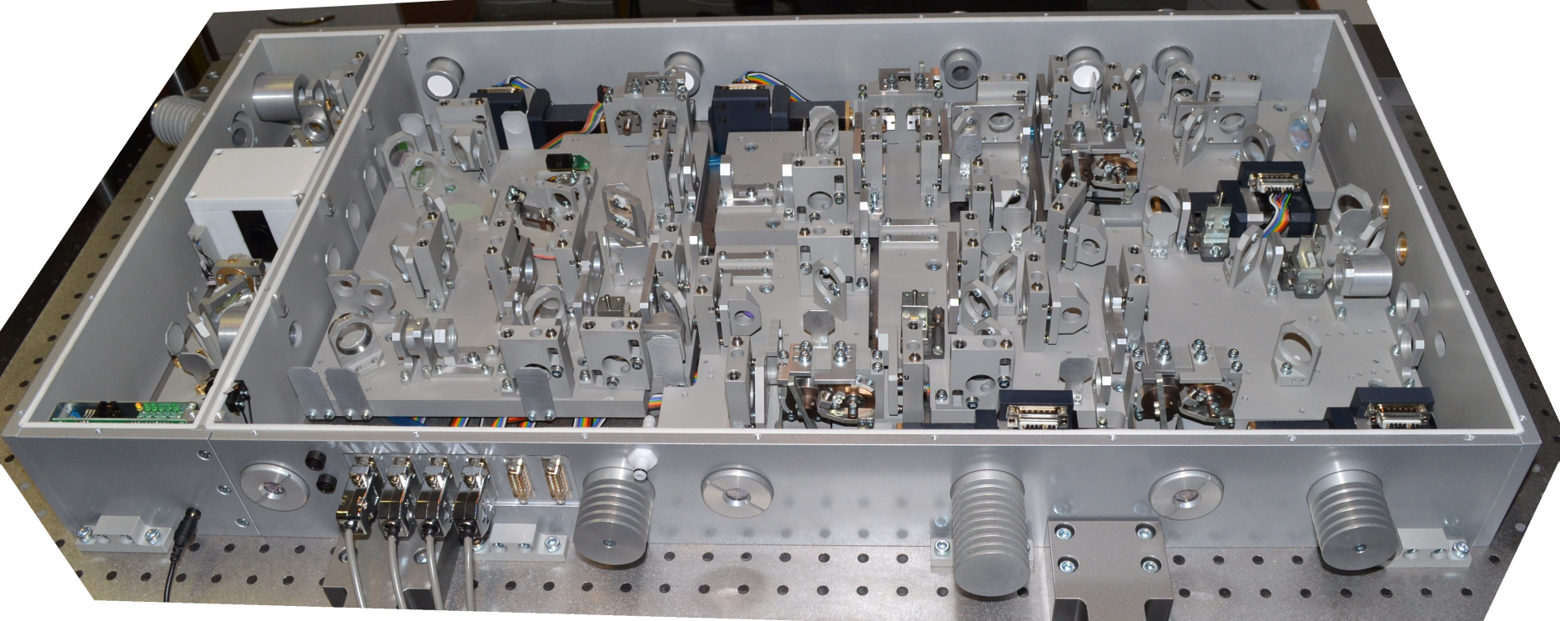
Mid-infared tunable optical parametric oscillator
Tunable spectral range, μm | 3…12
Maximum output energy, mJ | 20
Full beam divergence, mrad | 3..10

